Slide 1
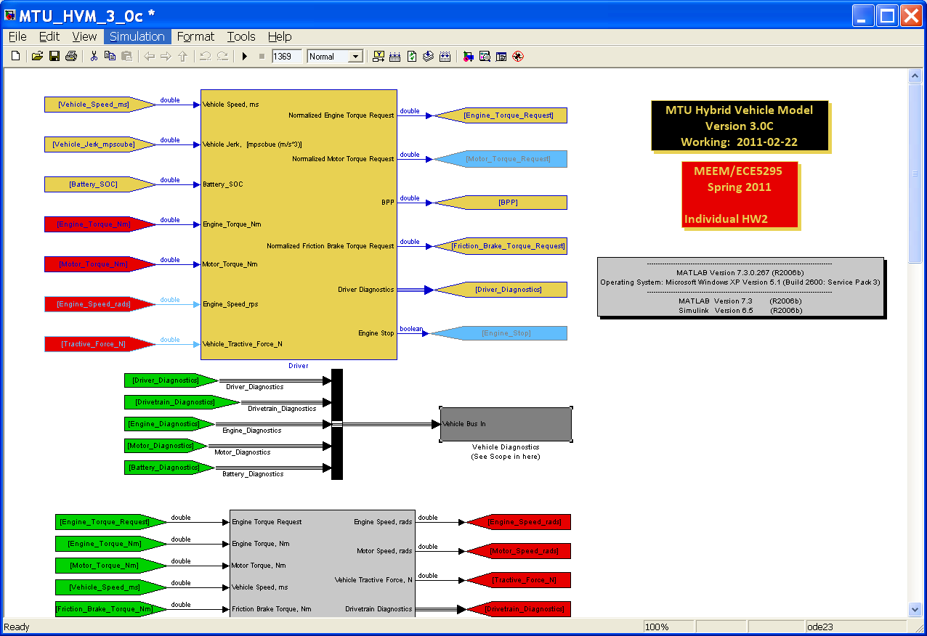
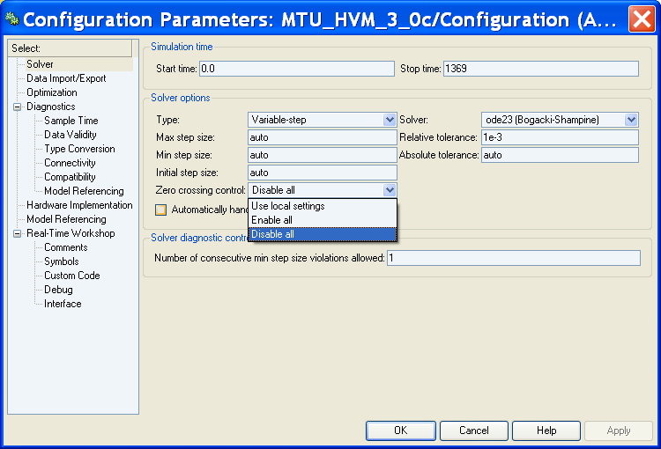
Disable Zero Crossing Control to Speed Execution
Version: R2006b

